Slide 1



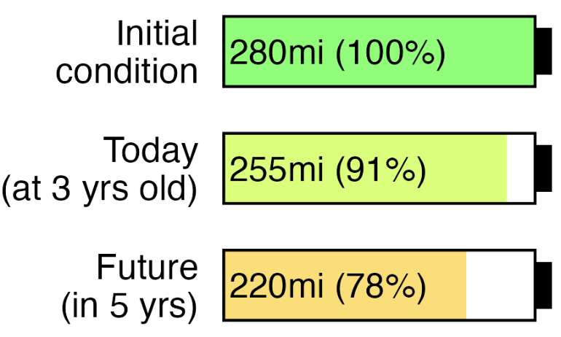
2022

Slide 2


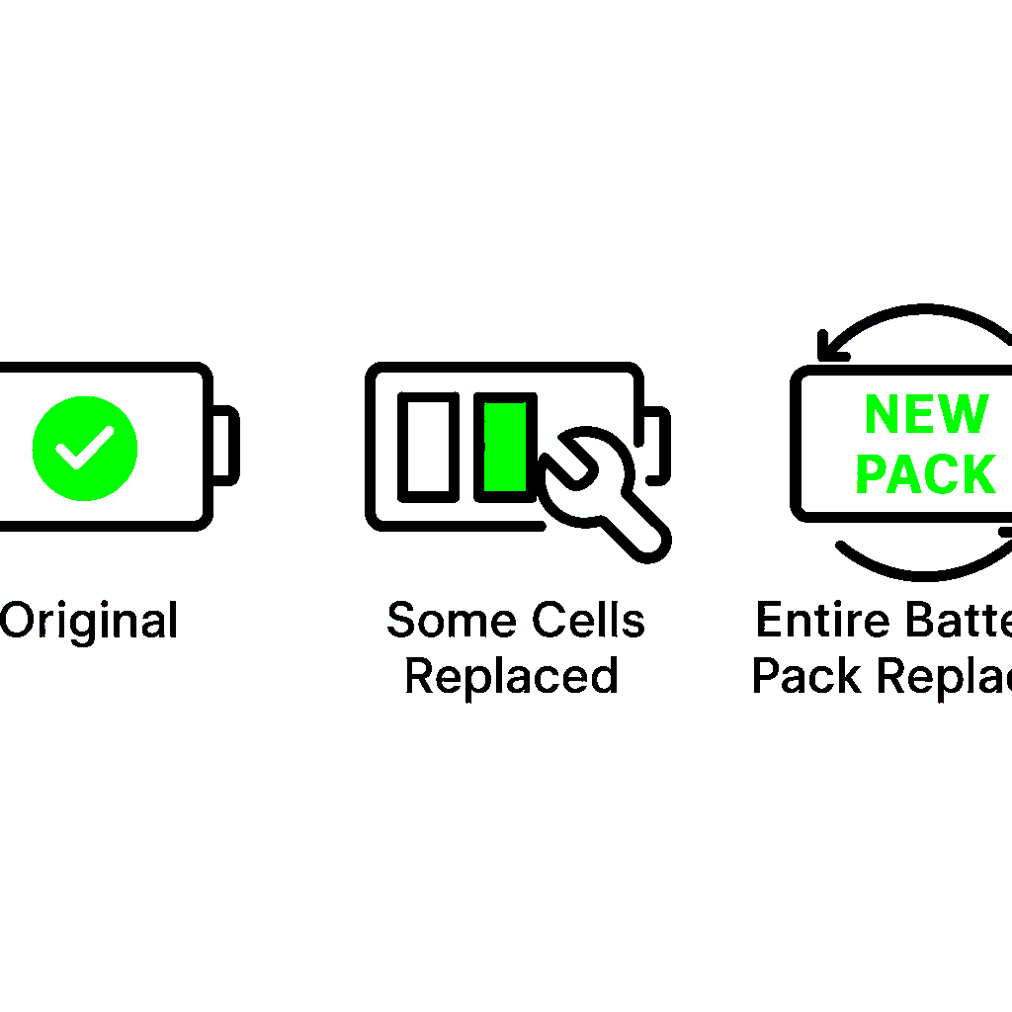





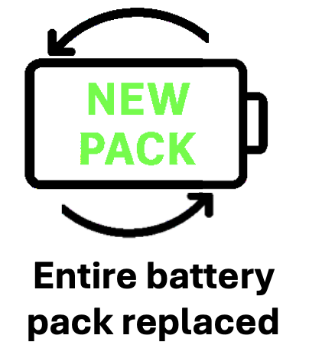


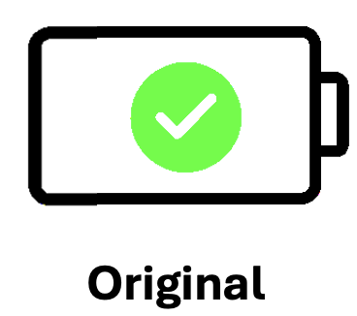
Original
Some cells replaced
Entire battery pack replaced

Slide 3
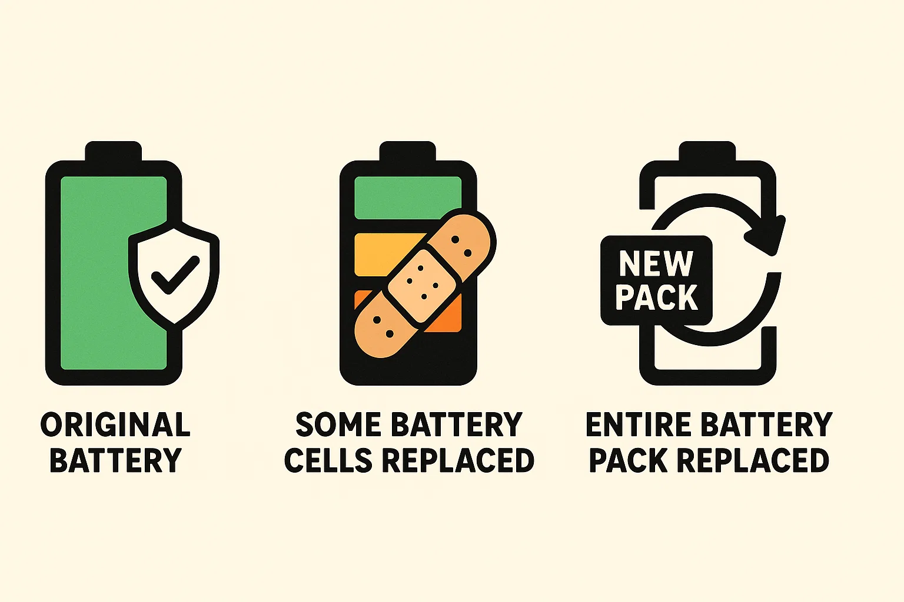
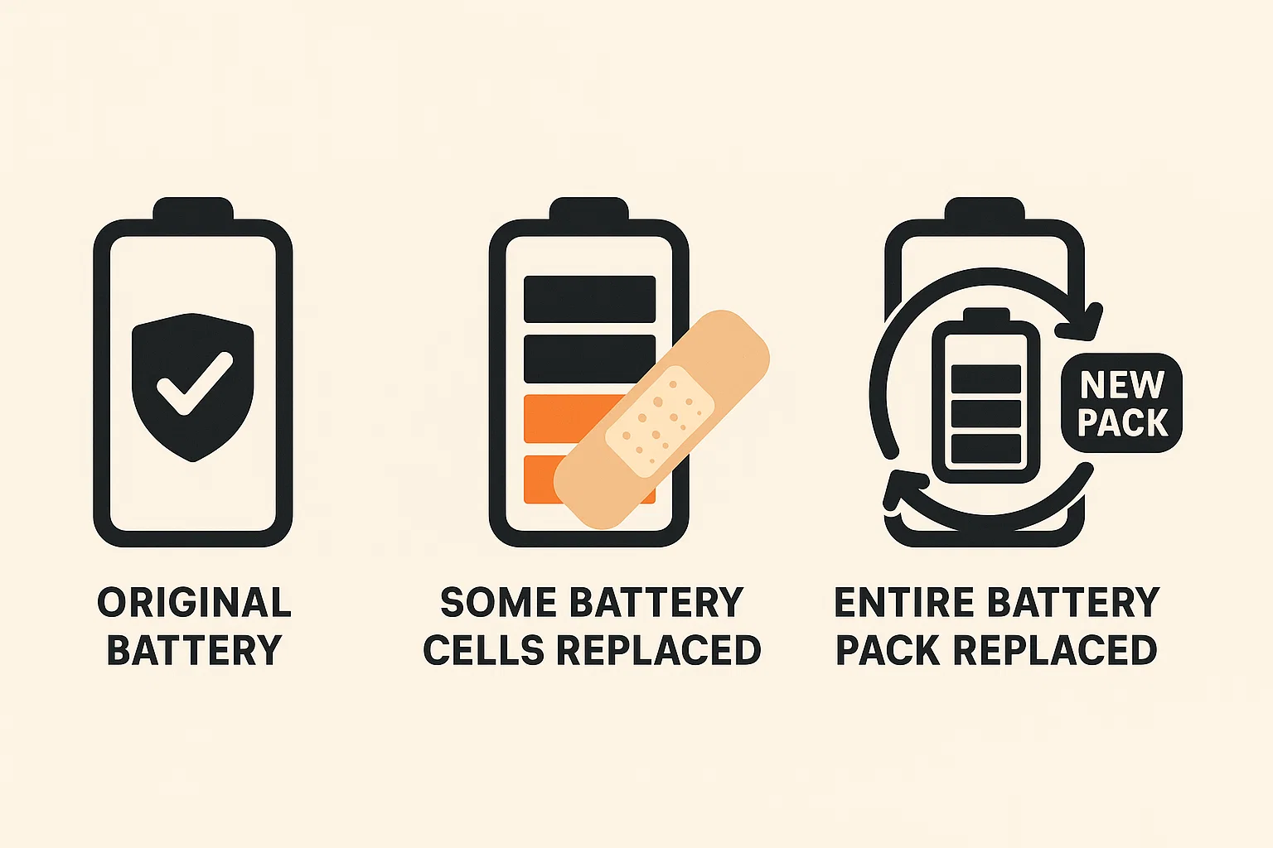
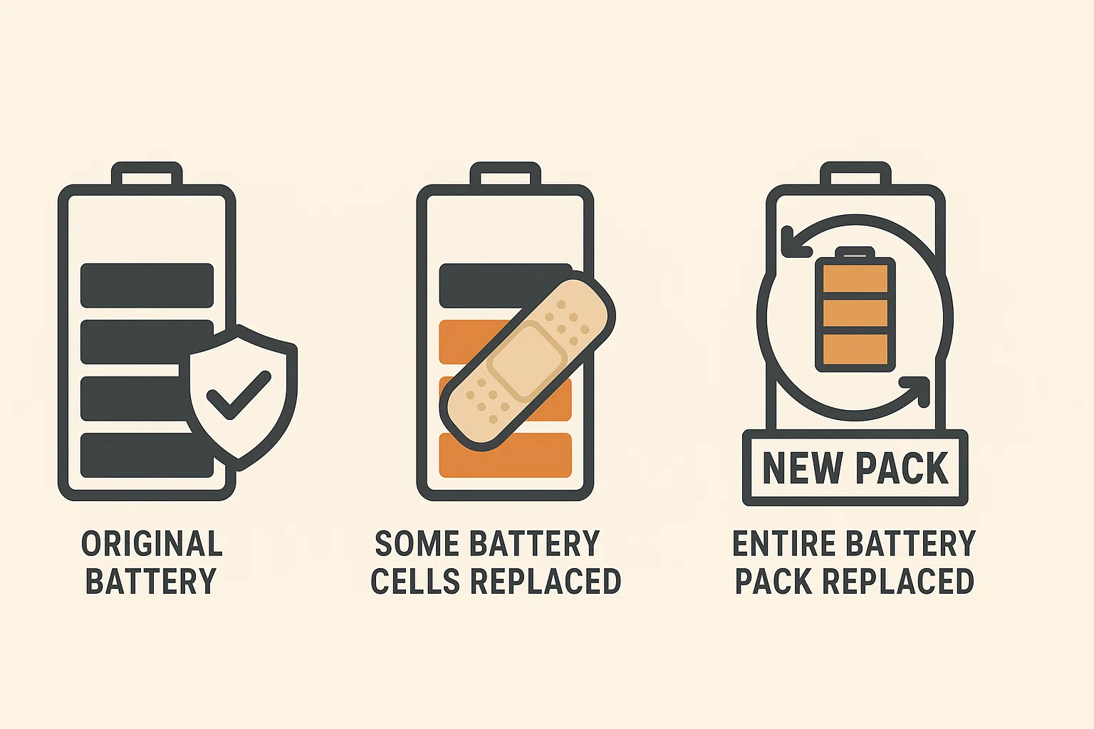
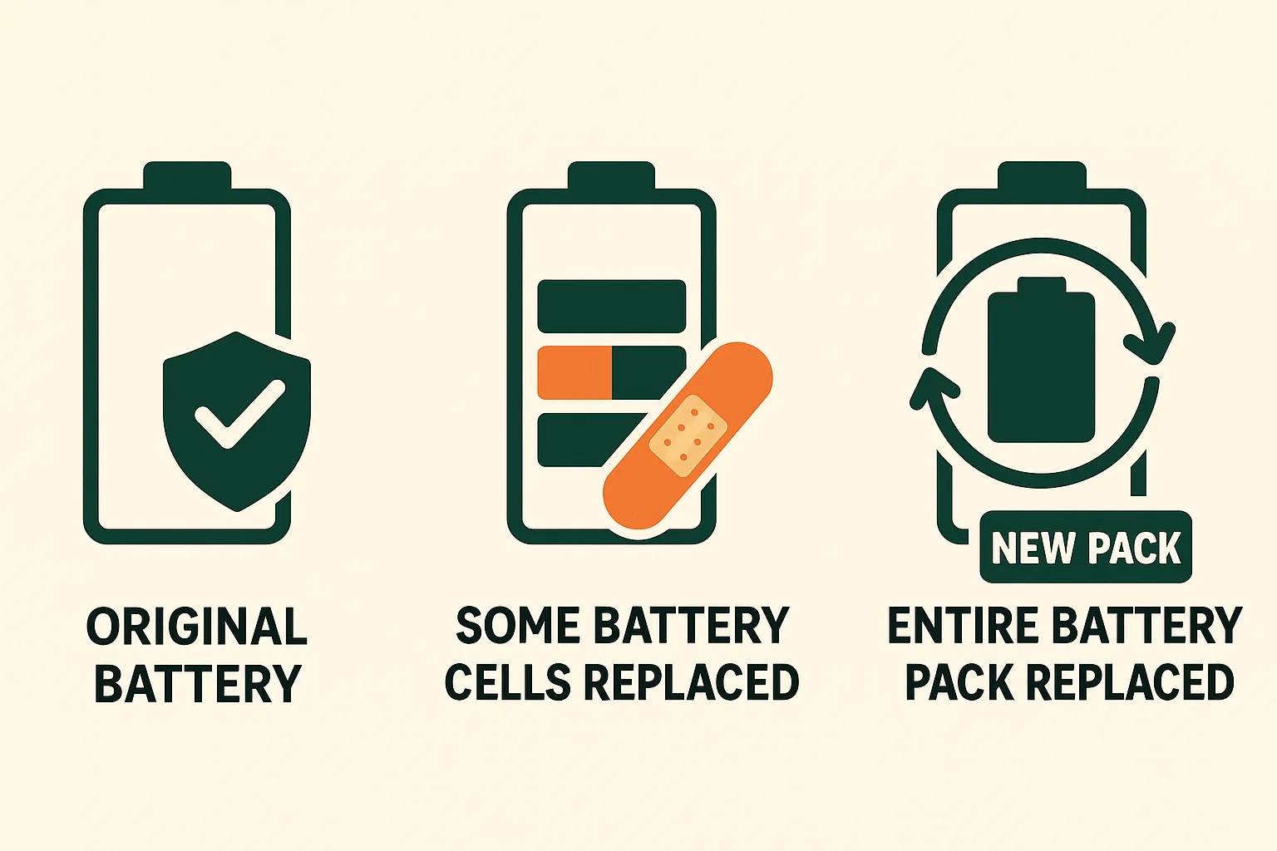
Battery replacements

Slide 4
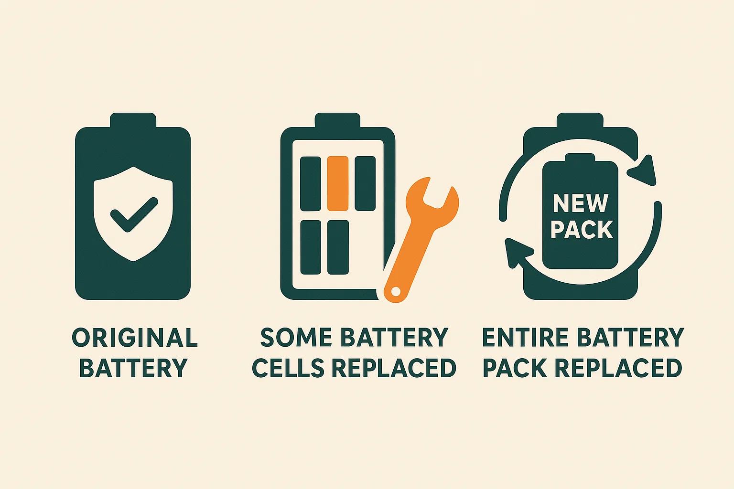
Battery replacements

Slide 5
Battery replacements

Slide 6
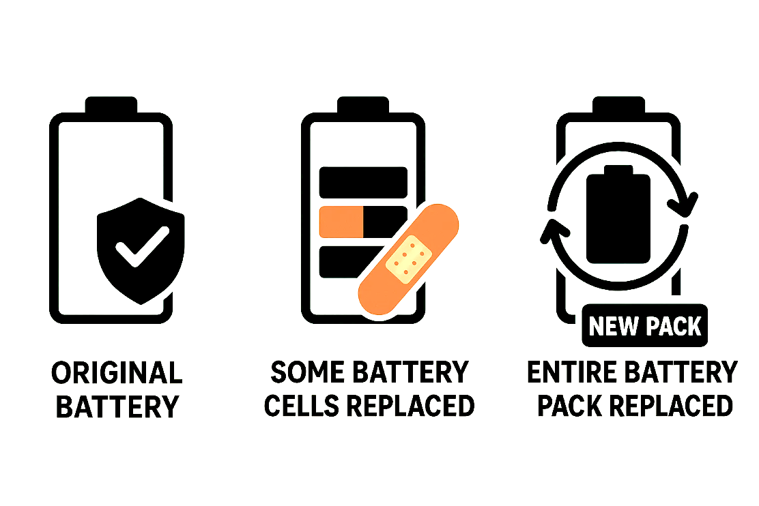
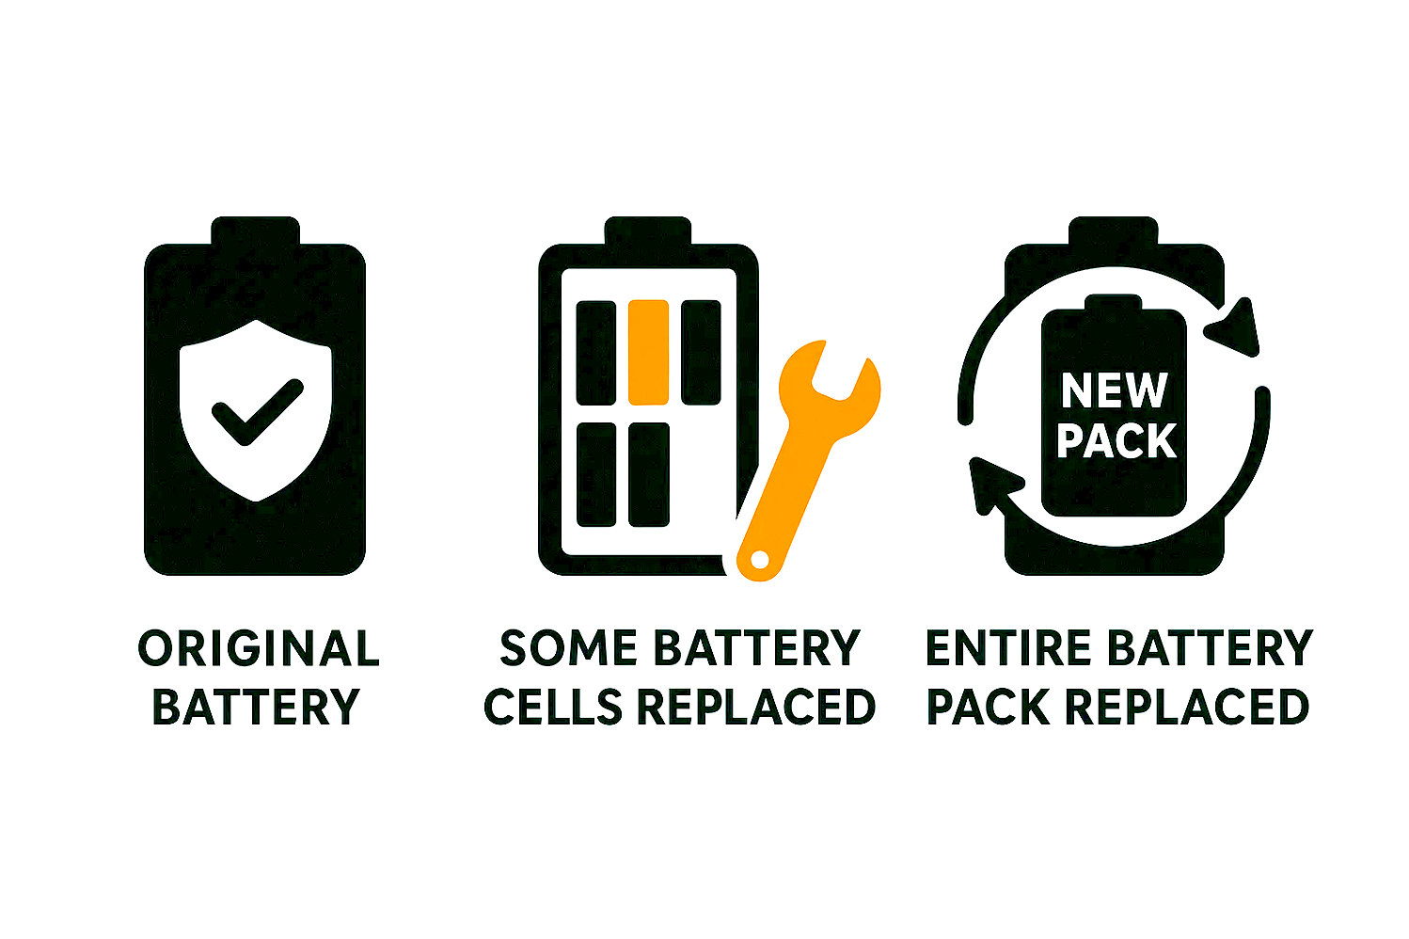
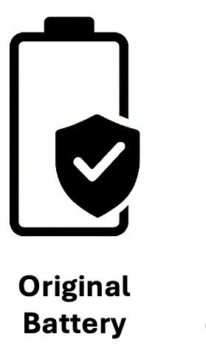
Original Battery
Some battery cells replaced
Entire battery pack replaced

Slide 7
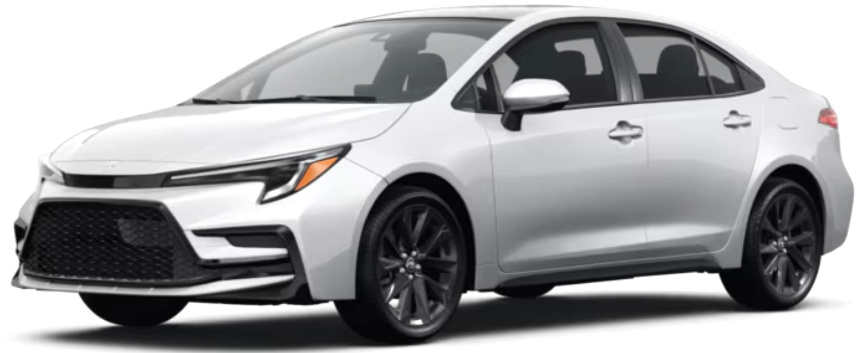
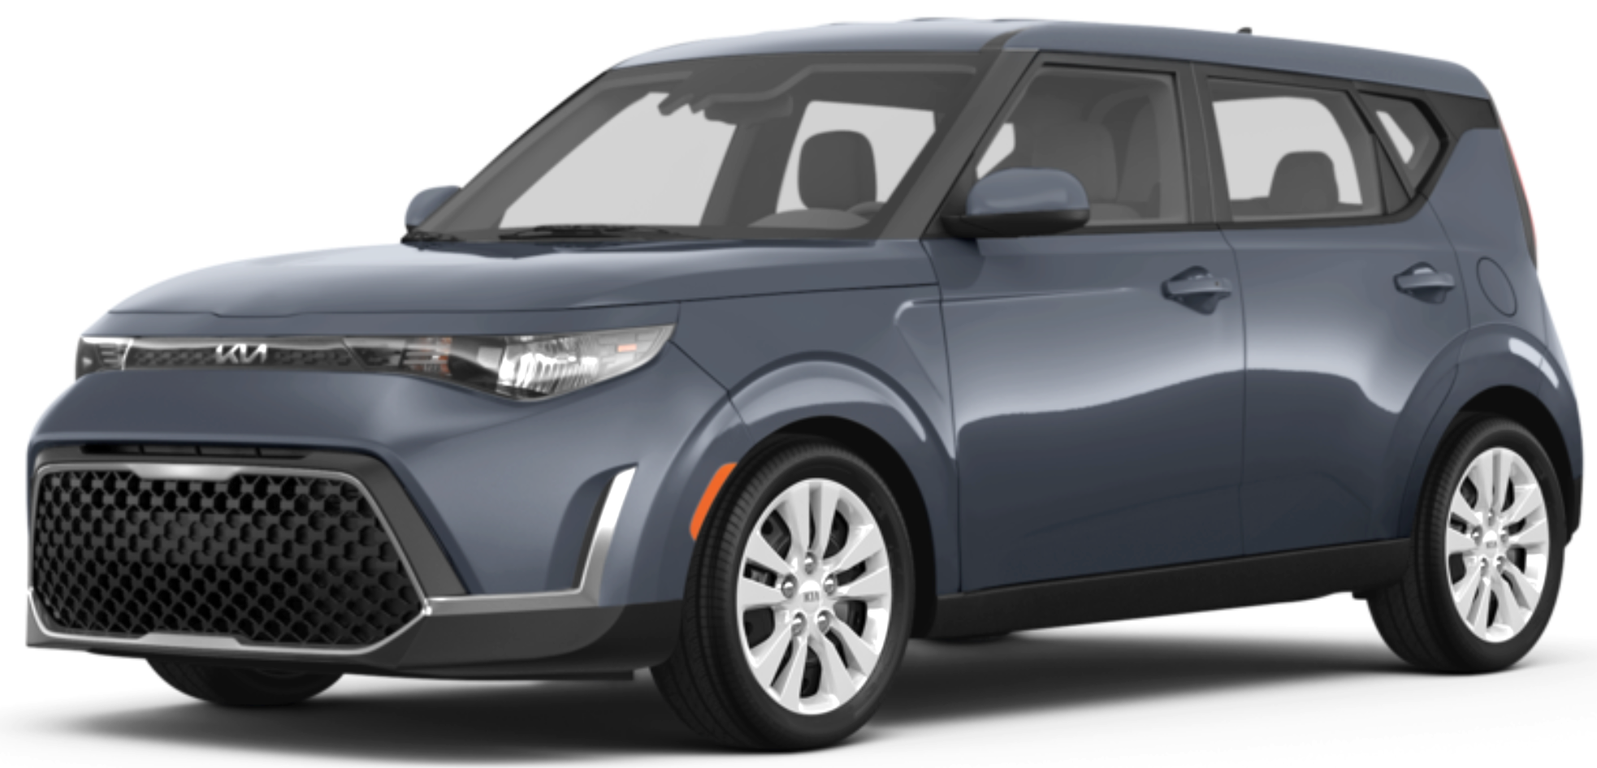
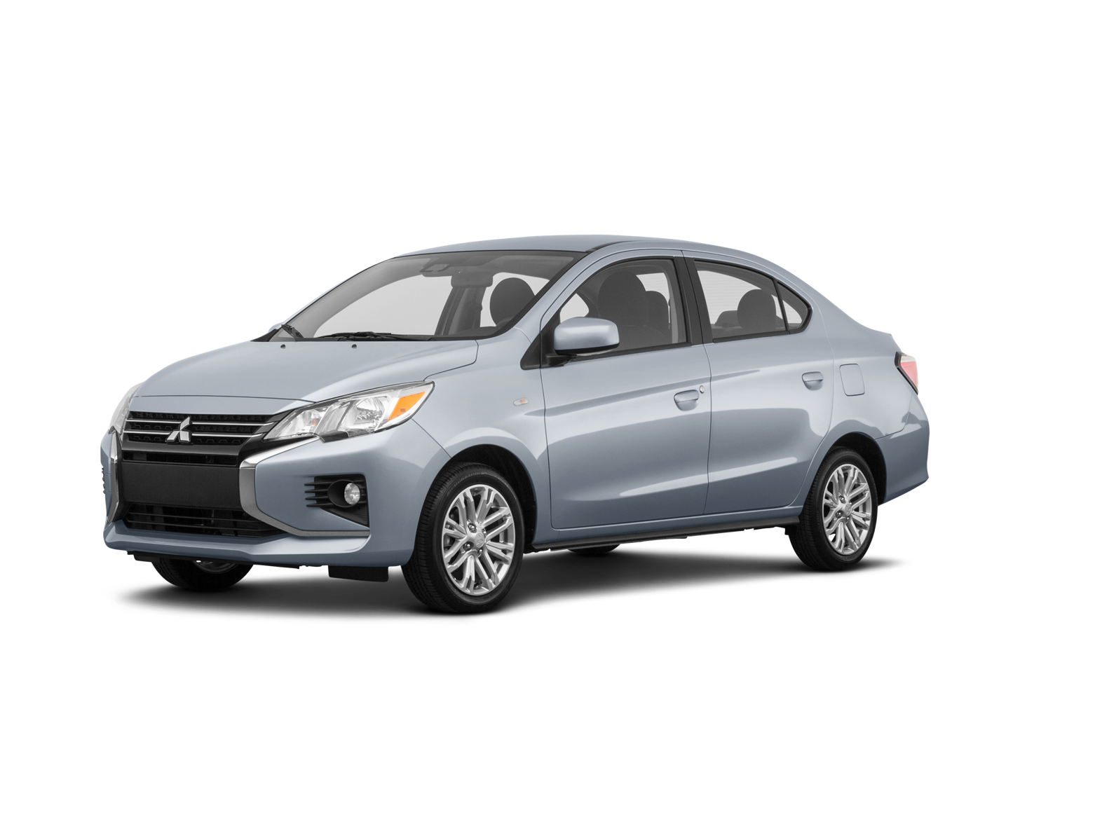
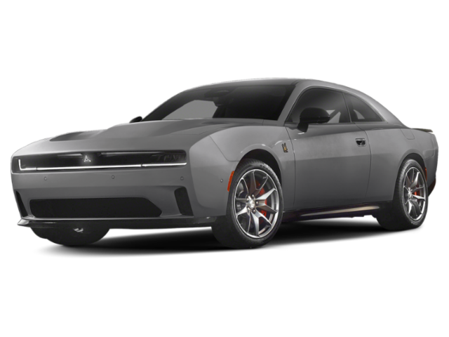
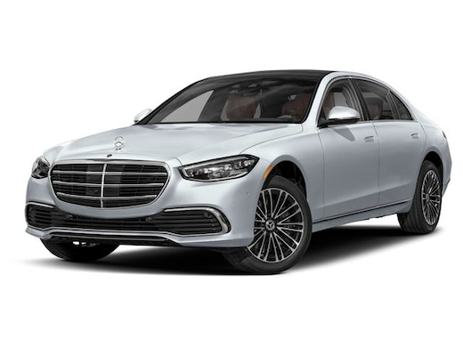
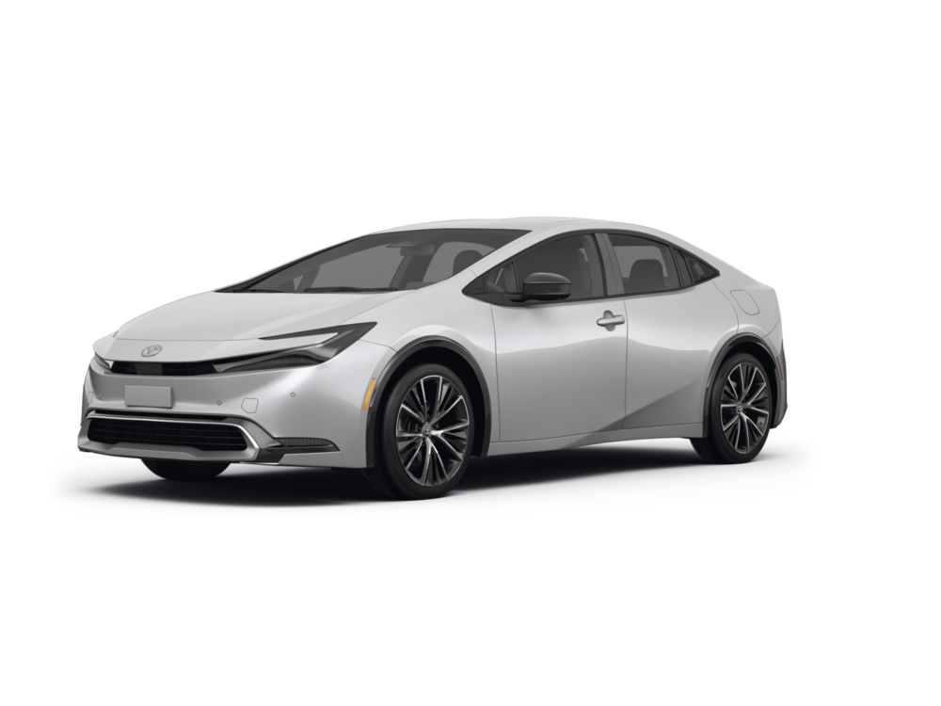
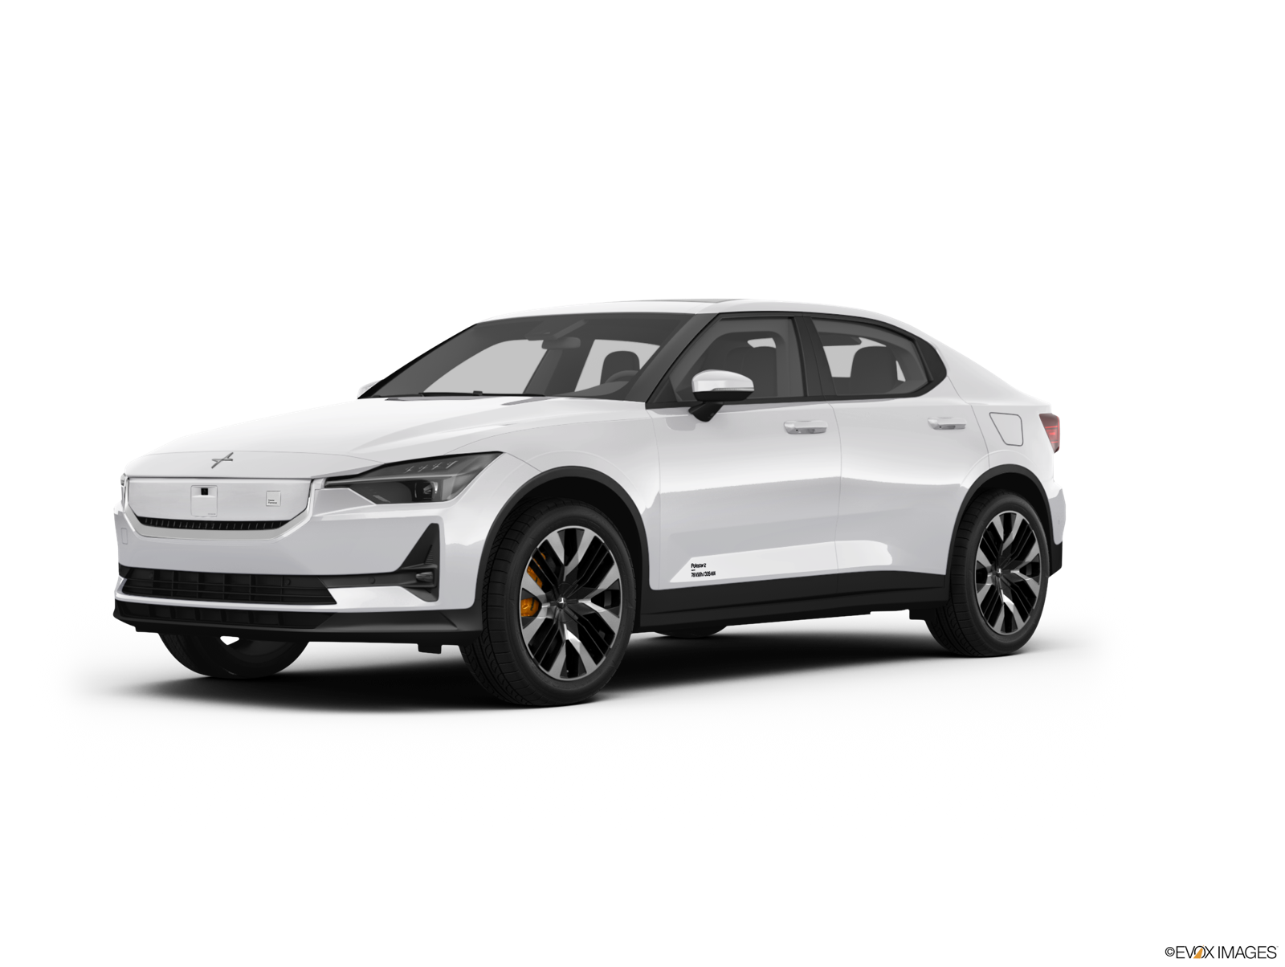
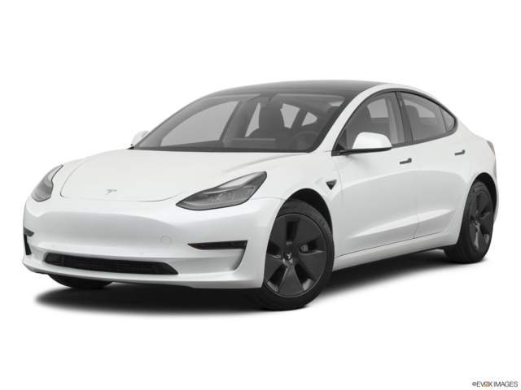
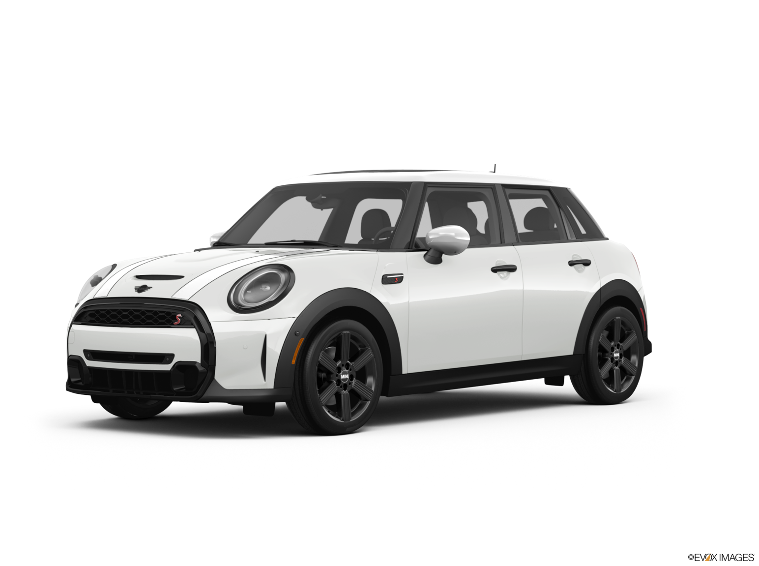
Best-selling Cars
Notes:
https://www.caranddriver.com/news/g64457986/bestselling-cars-2025/
https://www.kbb.com/best-cars/top-10-25-best-selling-cars-trucks-suvs/
https://www.kbb.com/car-news/the-25-best-selling-cars-of-2023/

Slide 8
Best-selling Cars
Notes:
https://www.caranddriver.com/news/g64457986/bestselling-cars-2025/
https://www.kbb.com/best-cars/top-10-25-best-selling-cars-trucks-suvs/
https://www.kbb.com/car-news/the-25-best-selling-cars-of-2023/

Slide 9
Best-selling Cars
Notes:
https://www.caranddriver.com/news/g64457986/bestselling-cars-2025/
https://www.kbb.com/best-cars/top-10-25-best-selling-cars-trucks-suvs/
https://www.kbb.com/car-news/the-25-best-selling-cars-of-2023/

Slide 10
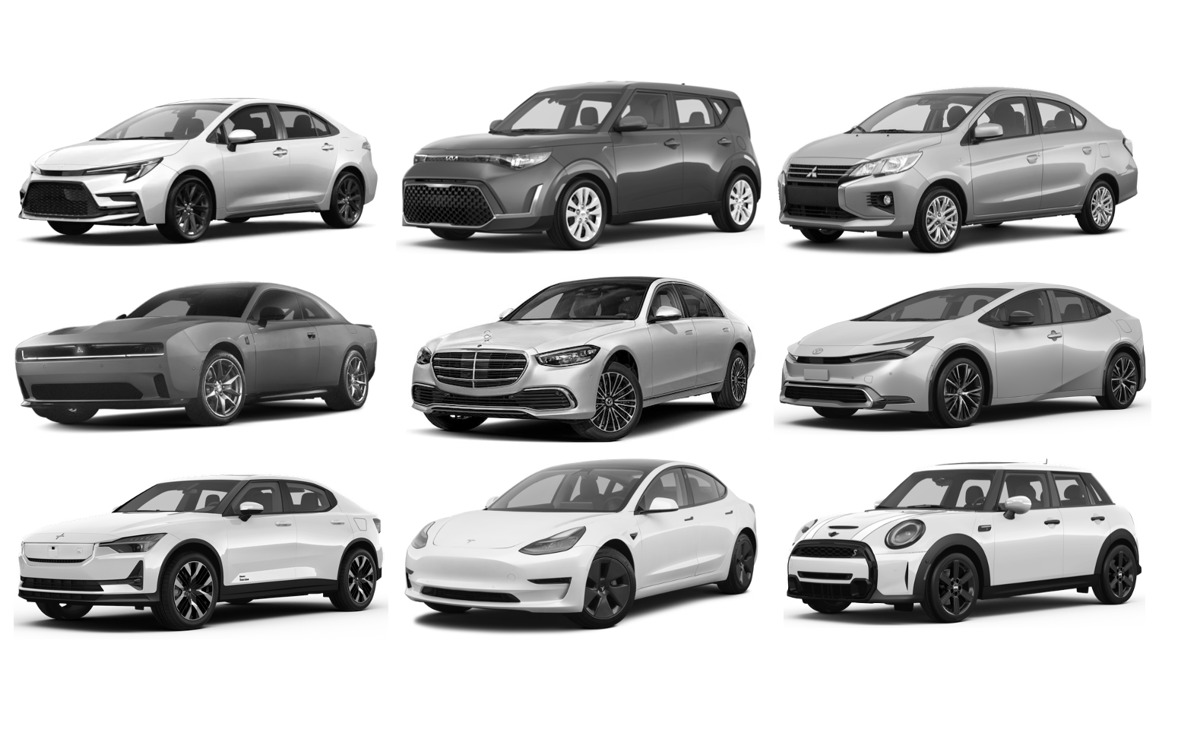
Best-selling Cars
Notes:
https://www.caranddriver.com/news/g64457986/bestselling-cars-2025/
https://www.kbb.com/best-cars/top-10-25-best-selling-cars-trucks-suvs/
https://www.kbb.com/car-news/the-25-best-selling-cars-of-2023/

Slide 11
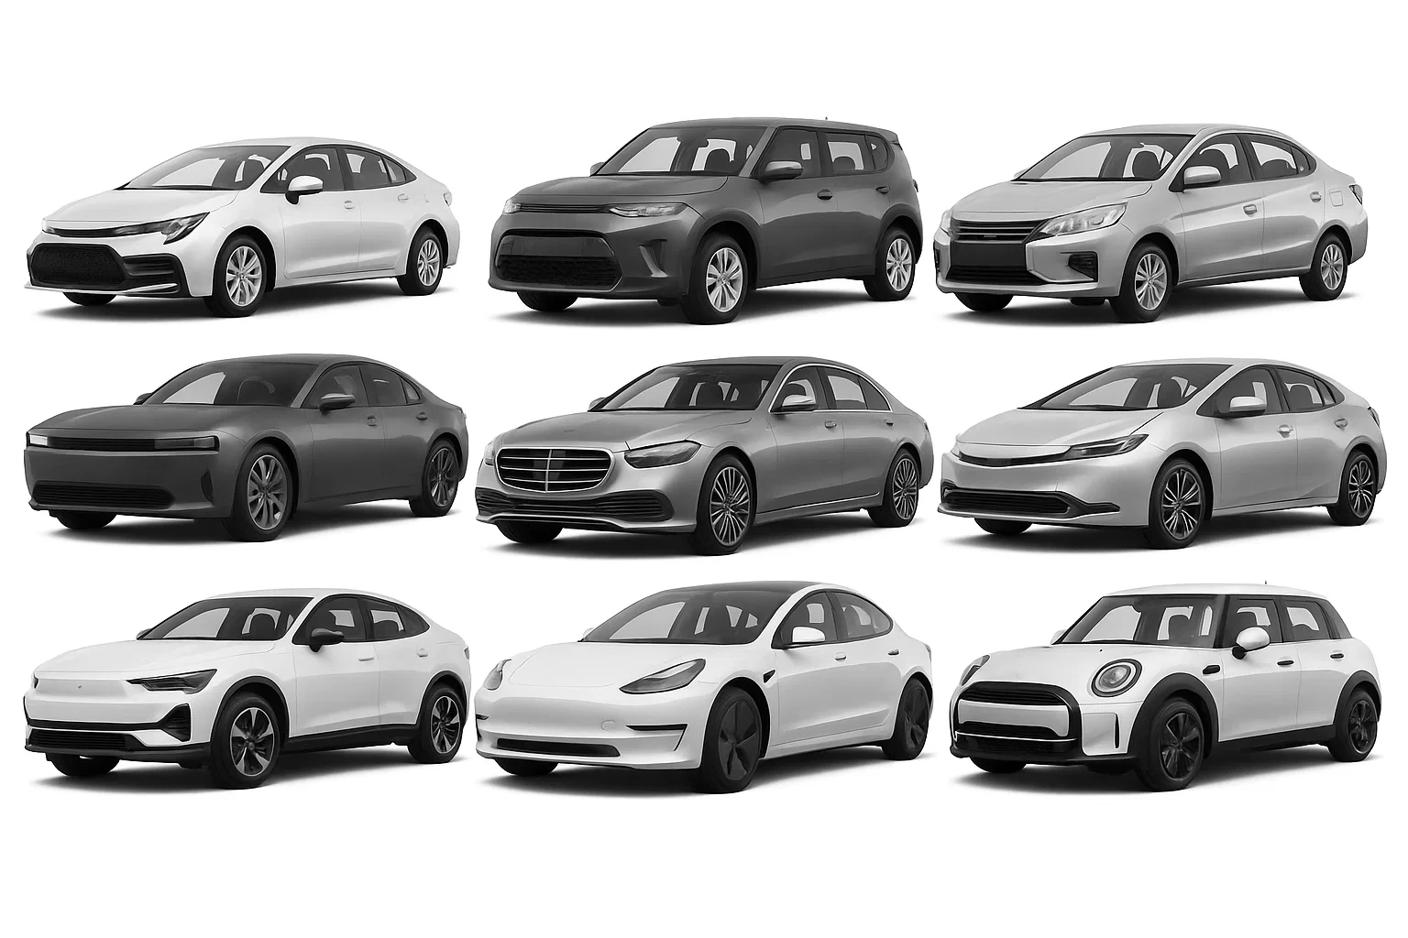
Best-selling Cars (AI-processed)
Notes:
https://www.caranddriver.com/news/g64457986/bestselling-cars-2025/
https://www.kbb.com/best-cars/top-10-25-best-selling-cars-trucks-suvs/
https://www.kbb.com/car-news/the-25-best-selling-cars-of-2023/

Slide 12
Best-selling Cars (AI-processed)
Notes:
https://www.caranddriver.com/news/g64457986/bestselling-cars-2025/
https://www.kbb.com/best-cars/top-10-25-best-selling-cars-trucks-suvs/
https://www.kbb.com/car-news/the-25-best-selling-cars-of-2023/

Slide 13
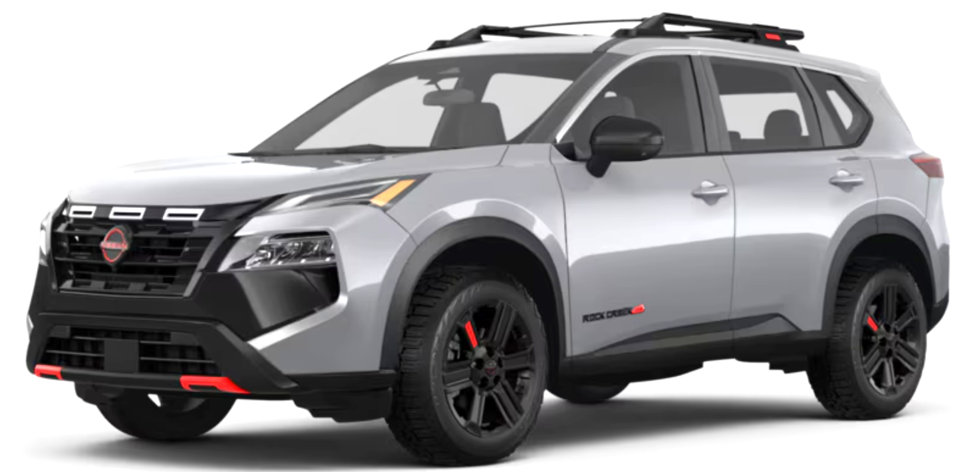
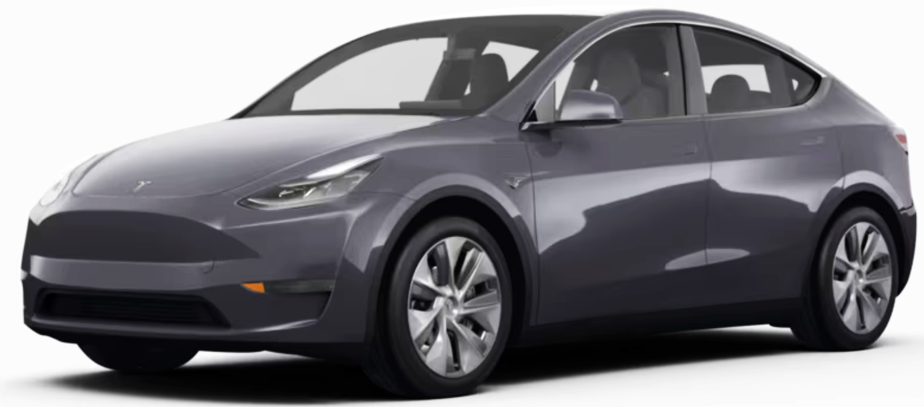
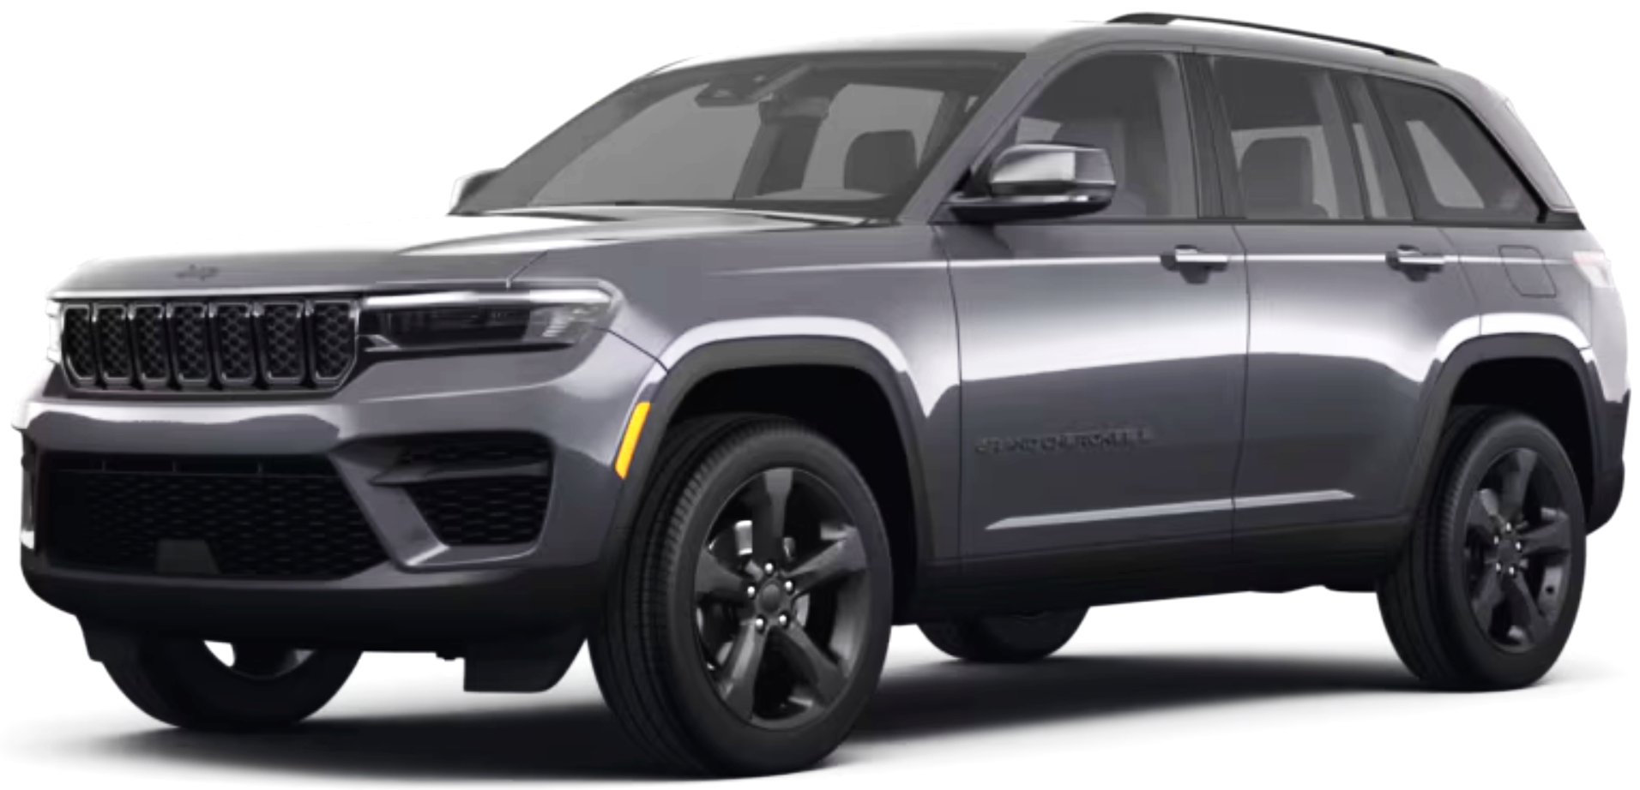
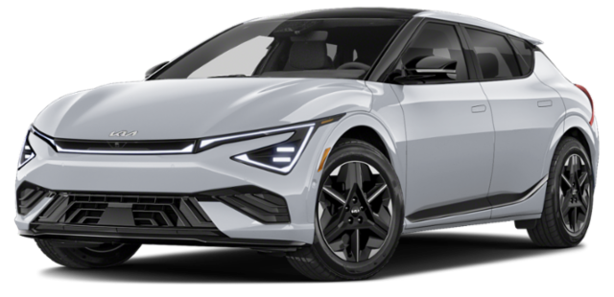
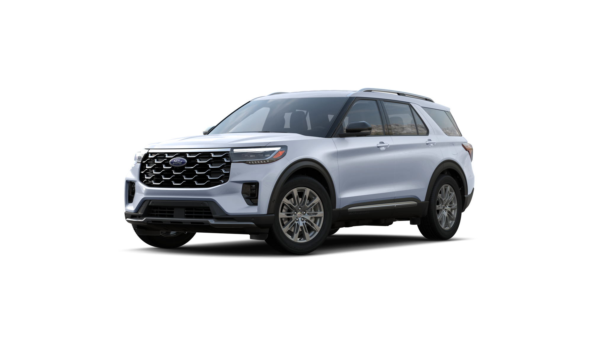
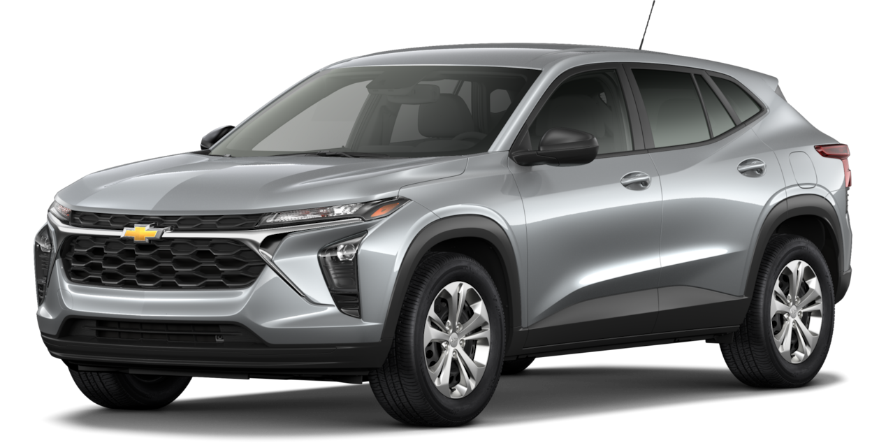
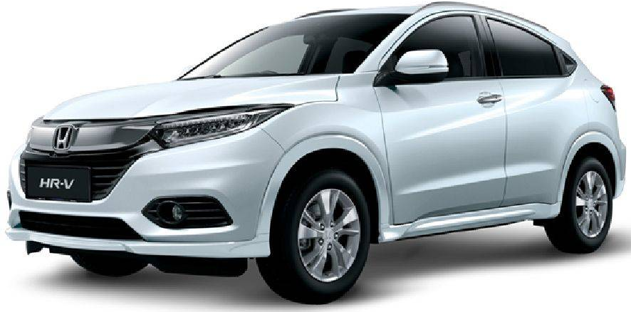
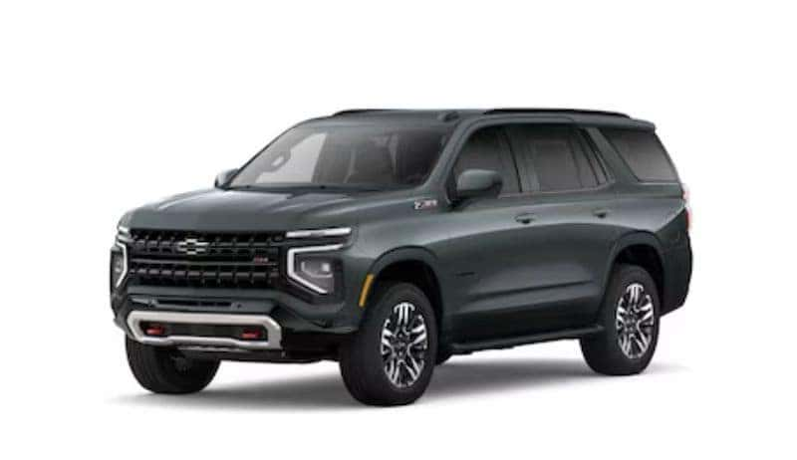
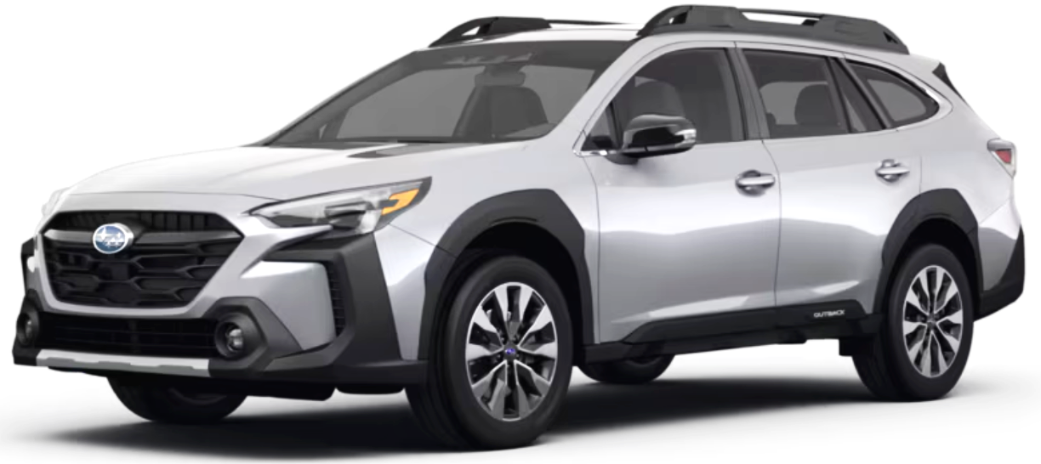
Best-selling SUVs/Crossovers
Notes:
https://www.caranddriver.com/news/g64457986/bestselling-cars-2025/
https://www.kbb.com/best-cars/top-10-25-best-selling-cars-trucks-suvs/
https://www.kbb.com/car-news/the-25-best-selling-cars-of-2023/

Slide 14
Best-selling SUVs/Crossovers
Notes:
https://www.caranddriver.com/news/g64457986/bestselling-cars-2025/
https://www.kbb.com/best-cars/top-10-25-best-selling-cars-trucks-suvs/
https://www.kbb.com/car-news/the-25-best-selling-cars-of-2023/

Slide 15
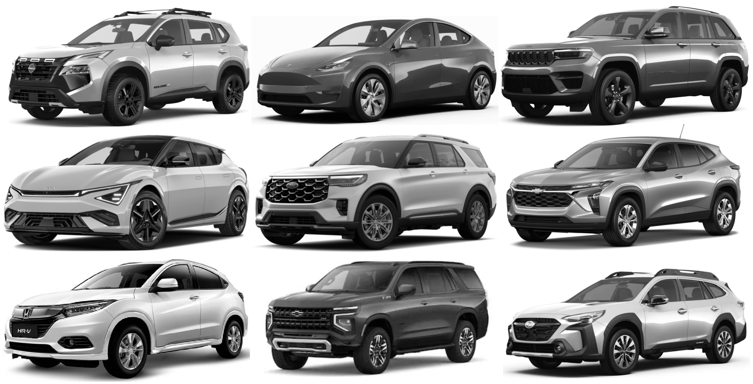
Best-selling SUVs/Crossovers
Notes:
https://www.caranddriver.com/news/g64457986/bestselling-cars-2025/
https://www.kbb.com/best-cars/top-10-25-best-selling-cars-trucks-suvs/
https://www.kbb.com/car-news/the-25-best-selling-cars-of-2023/

Slide 16
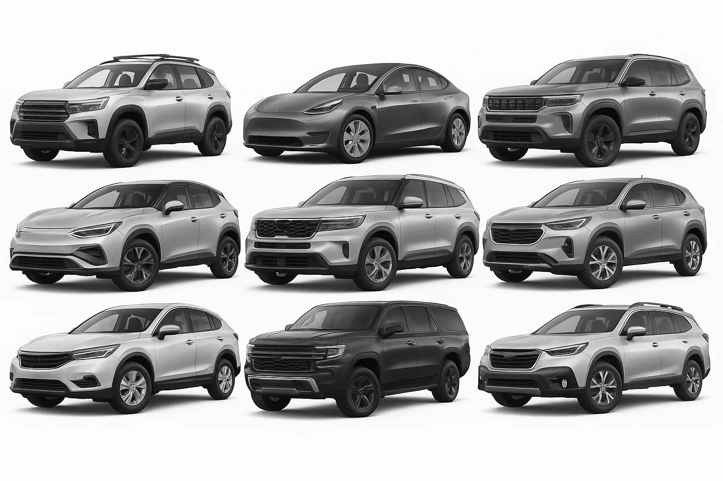
Best-selling SUVs/Crossovers (AI-processed)
Notes:
https://www.caranddriver.com/news/g64457986/bestselling-cars-2025/
https://www.kbb.com/best-cars/top-10-25-best-selling-cars-trucks-suvs/
https://www.kbb.com/car-news/the-25-best-selling-cars-of-2023/

Slide 17
Best-selling SUVs/Crossovers (AI-processed)
Notes:
https://www.caranddriver.com/news/g64457986/bestselling-cars-2025/
https://www.kbb.com/best-cars/top-10-25-best-selling-cars-trucks-suvs/
https://www.kbb.com/car-news/the-25-best-selling-cars-of-2023/

